Slide 1
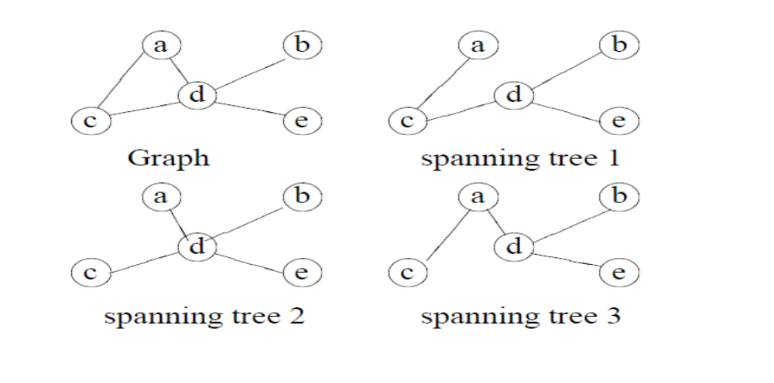
Spanning trees
Spanning Trees: A subgraph T of a undirected graph G = (V , E) is a spanning tree of G if it is a tree and contains every vertex of G.
1

Slide 2
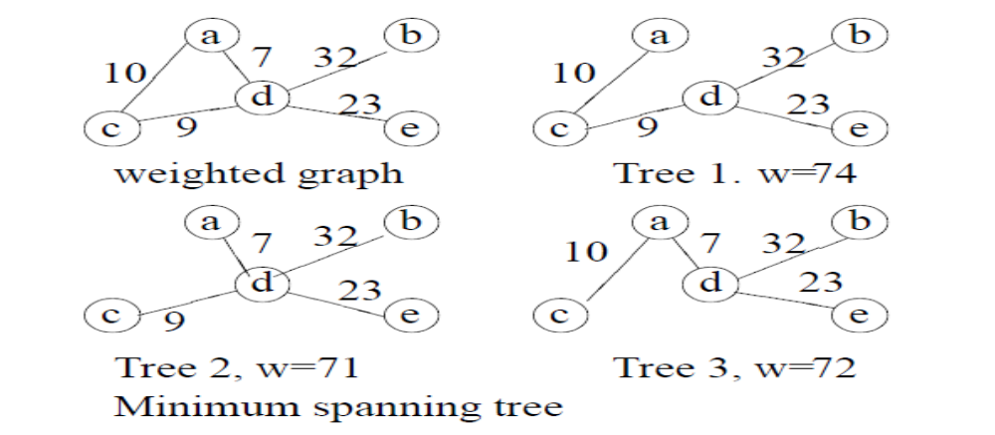
Weighted Graphs
Weighted Graphs: A weighted graph is a graph, in which each edge has a weight (some real number).
Weight of a Graph: The sum of the weights of all edges.

Slide 3
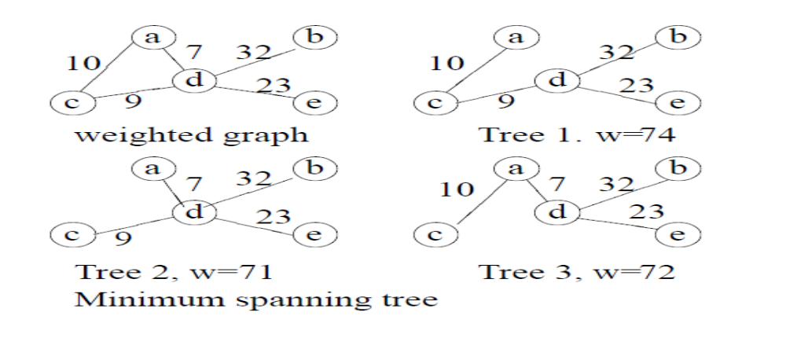
Minimum spanning trees
A Minimum Spanning Tree in an undirected connected weighted graph is a spanning tree of minimum weight (among all spanning trees).

Slide 4

5
A
B
4
6
2
C
2
D
3
3
1
2
E
F
4

Slide 5
Spanning Trees
5
A
B
6
4
2
C
2
D
3
3
1
2
E
F
4

Slide 6
5
A
B
4
6
2
C
2
D
3
3
1
2
E
F
4

Slide 7
5
A
B
4
6
2
C
2
D
3
3
1
2
E
F
4

Slide 8
5
A
B
4
6
2
C
2
D
3
3
1
2
E
F
4

Slide 9
5
A
B
4
6
2
C
2
D
3
cycle!!
3
1
2
E
F
4

Slide 10
5
A
B
4
6
2
C
2
D
3
3
1
2
E
F
4

Slide 11
5
A
B
4
6
2
C
2
D
3
3
1
2
E
F
4

Slide 12
Minimum Spanning Tree
A
B
2
C
2
D
3
1
2
E
F

Slide 13
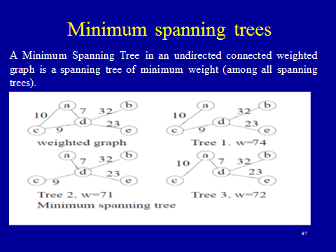

Slide 14
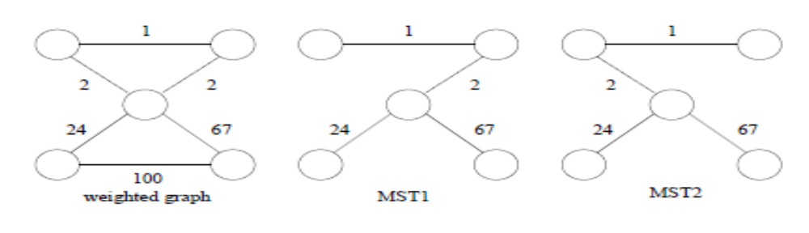
Minimum Spanning Trees
Remark: The minimum spanning tree may not be unique. However, if the weights of all the edges are pairwise distinct, it is indeed unique (we won’t prove this now).

Slide 15
Minimum Connector Algorithms
Prim’s algorithm
Select any vertex
Select the shortest edge connected to that vertex
Select the shortest edge connected to any vertex already connected
Repeat step 3 until all vertices have been connected

Slide 16
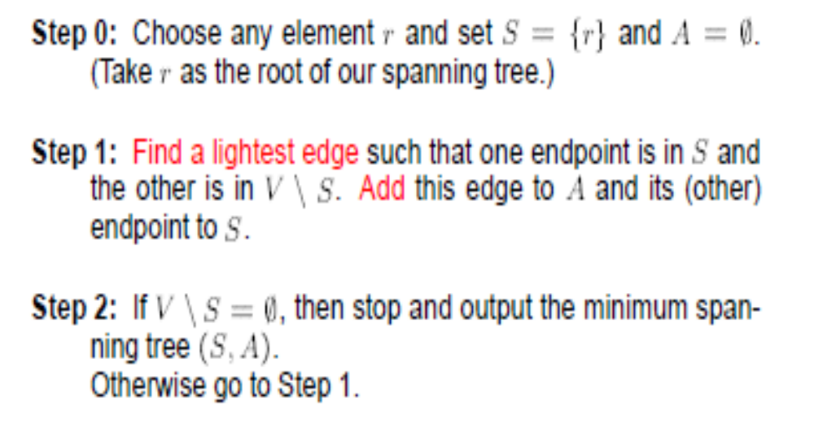
Prim’s Algorithm

Slide 17
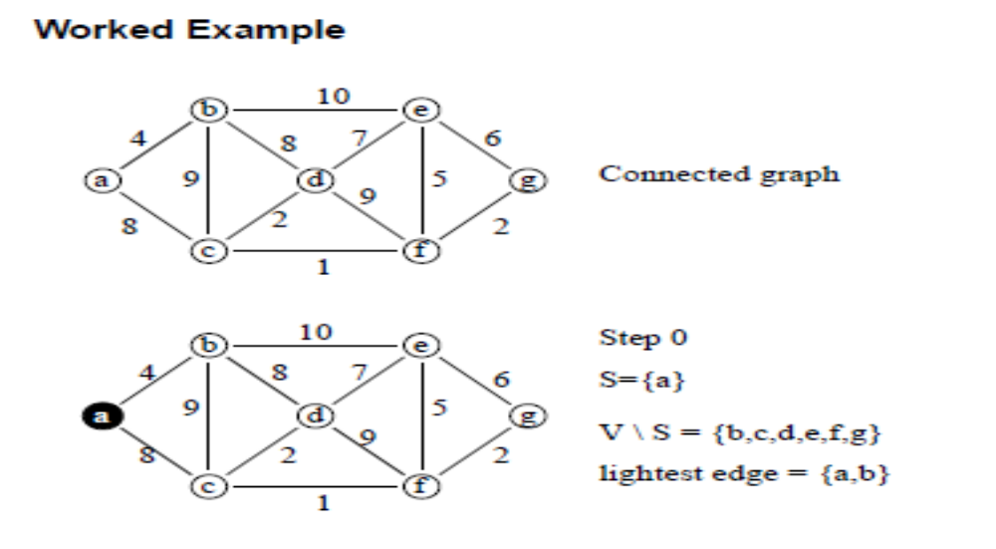
Prim’s Algorithm

Slide 18
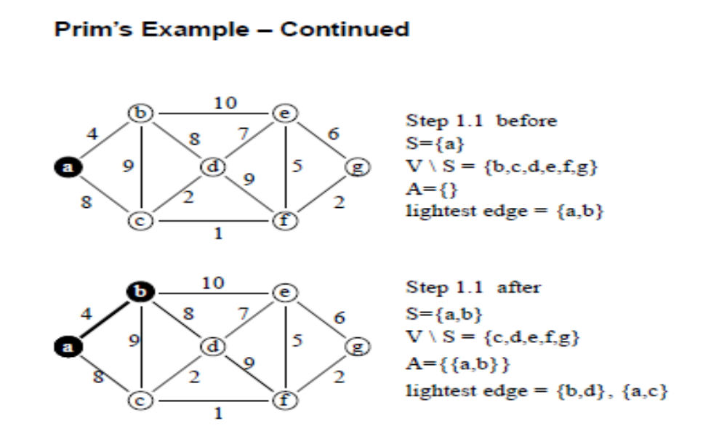
Prim’s Algorithm

Slide 19
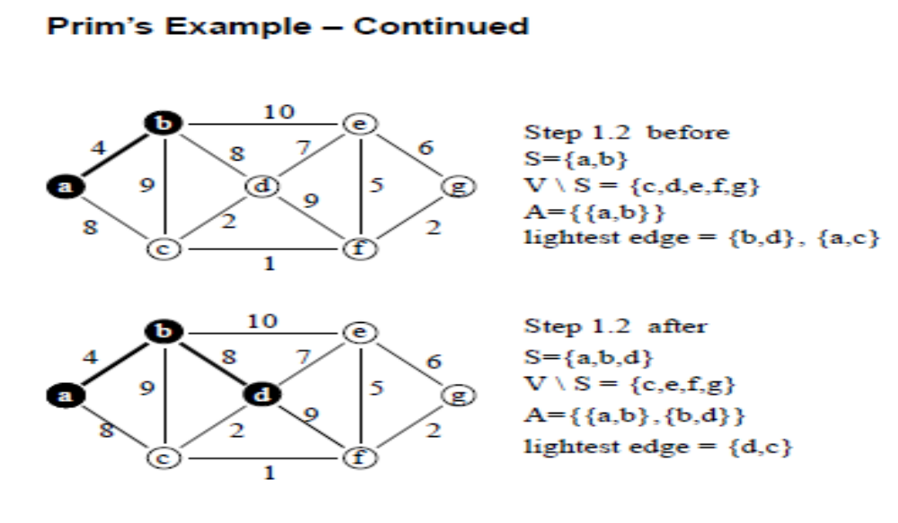
Prim’s Algorithm

Slide 20
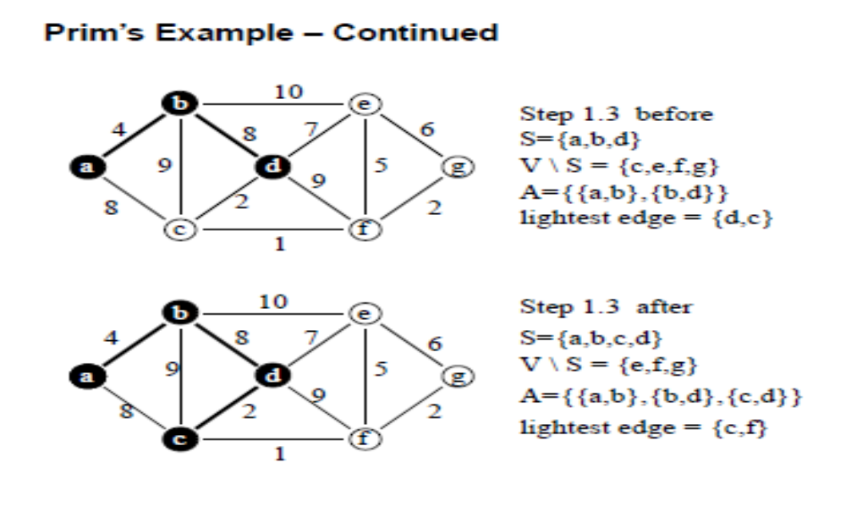
Prim’s Algorithm

Slide 21
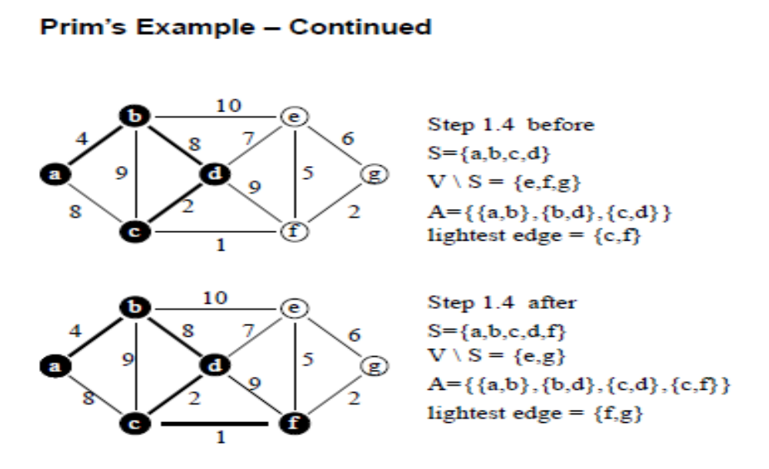
Prim’s Algorithm

Slide 22
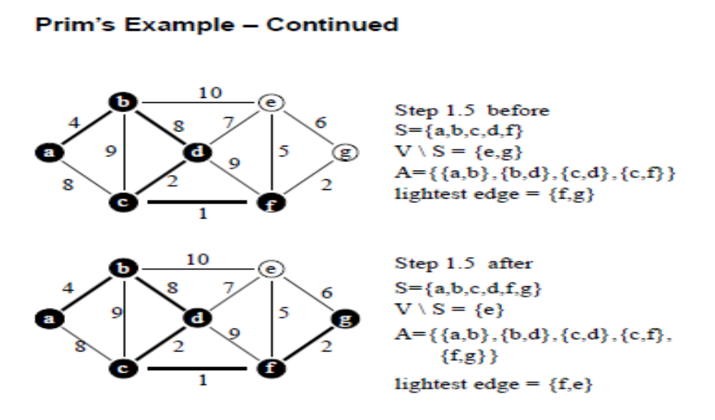
Prim’s Algorithm

Slide 23
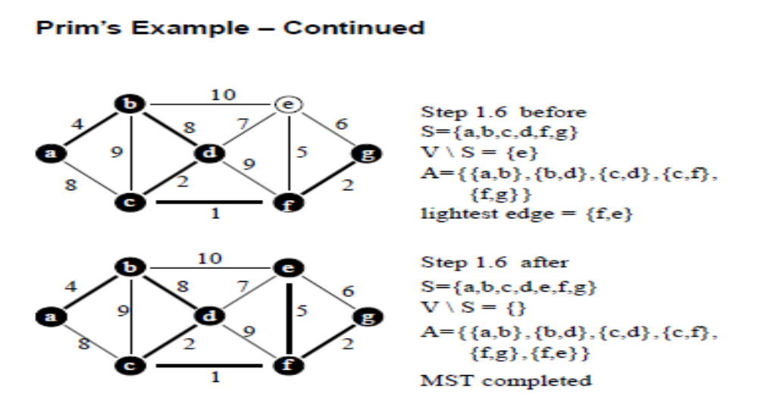
Prim’s Algorithm

Slide 24
Minimum Connector Algorithms
Kruskal’s algorithm
Select the shortest edge in a network
Select the next shortest edge which does not create a cycle
Repeat step 2 until all vertices have been connected

Slide 25
Kruskal’s Algorithm: Tree Construction
←
←
{A,B} 1
{D,F} 2
{B,C} 4
{A,D} 5
{C,D} 5
{E,D} 6
{A,E} 7
{B,D} 8
E
←
E
7
6
←
6
A
5
D
←
A
5
D
1
8
2
←
2
5
1
B
C
F
←
4
B
C
F
←
4
Example 1

Slide 26
A cable company want to connect five villages to their network which currently extends to the market town of Avonford. What is the minimum length of cable needed?
Example 2
Brinleigh
5
Cornwell
3
4
8
6
8
Avonford
Fingley
Donster
7
5
4
2
Edan

Slide 27
We model the situation as a network, then the problem is to find the minimum connector for the network
B
5
C
3
4
8
6
8
A
F
D
7
5
4
2
E

Slide 28
Kruskal’s Algorithm
List the edges in order of size:
ED 2
AB 3
AE 4
CD 4
BC 5
EF 5
CF 6
AF 7
BF 8
CF 8
B
5
C
3
4
8
6
8
A
D
7
F
5
4
2
E

Slide 29
Kruskal’s Algorithm
Select the shortest
edge in the network
ED 2
B
5
C
3
4
8
6
8
A
D
7
F
5
4
2
E

Slide 30
Kruskal’s Algorithm
Select the next shortest
edge which does not
create a cycle
ED 2
AB 3
B
5
C
3
4
8
6
8
A
D
7
F
5
4
2
E

Slide 31
Kruskal’s Algorithm
Select the next shortest
edge which does not
create a cycle
ED 2
AB 3
CD 4 (or AE 4)
B
5
C
3
4
8
6
8
A
D
7
F
5
4
2
E

Slide 32
Kruskal’s Algorithm
Select the next shortest
edge which does not
create a cycle
ED 2
AB 3
CD 4
AE 4
B
5
C
3
4
8
6
8
A
D
7
F
5
4
2
E

Slide 33
Kruskal’s Algorithm
Select the next shortest
edge which does not
create a cycle
ED 2
AB 3
CD 4
AE 4
BC 5 – forms a cycle
EF 5
B
5
C
3
4
8
6
8
A
D
7
F
5
4
2
E

Slide 34
Kruskal’s Algorithm
All vertices have been
connected.
The solution is
ED 2
AB 3
CD 4
AE 4
EF 5
Total weight of tree: 18
B
5
C
3
4
8
6
8
A
D
7
F
5
4
2
E

Slide 35
Example 2
Prim’s Algorithm
Select any vertex
A
Select the shortest edge connected to that vertex
AB 3
B
5
C
3
4
8
6
8
A
D
7
F
5
4
2
E

Slide 36
Prim’s Algorithm
Select the shortest
edge connected to
any vertex already
connected.
AE 4
B
5
C
3
4
8
6
8
A
D
7
F
5
4
2
E

Slide 37
Prim’s Algorithm
Select the shortest
edge connected to
any vertex already
connected.
ED 2
B
5
C
3
4
8
6
8
A
D
7
F
5
4
2
E

Slide 38
Prim’s Algorithm
Select the shortest
edge connected to
any vertex already
connected.
DC 4
B
5
C
3
4
8
6
8
A
D
7
F
5
4
2
E

Slide 39
Prim’s Algorithm
Select the shortest
edge connected to
any vertex already
connected.
EF 5
B
5
C
3
4
8
6
8
A
D
7
F
5
4
2
E

Slide 40
Prim’s Algorithm
All vertices have been
connected.
The solution is
AB 3
AE 4
ED 2
DC 4
EF 5
Total weight of tree: 18
B
5
C
3
4
8
6
8
A
D
7
F
5
4
2
E

Slide 41
Some Points To Note
Both algorithms will always give solutions with the same length.
They will usually select edges in a different order – you must show this in your workings.
Occasionally they will use different edges – this may happen when you have to choose between edges with the same length. In this case there is more than one minimum connector for the network.

